Slide 1
The North African Colonial City
Prior to European colonization regions of Africa already exhibited towns.
→pre-existing towns were located in northern Africa, western Africa, and in east coast Swahili city-states.
Europeans were limited to adopting and adapting structures already in existence.
The new settler town in North Africa was built as an addition to the existing Islamic city.

Slide 2
Two distinct, self-contained sectors of the North African Colonial City The Medina and the Nouvelle Ville
The Islamic Cities (medinas)
→possessed walled enclosures
→continued to function much the same before and after conquest
→central to trading and agricultural economies
Medinas exhibited a very strict pattern of land use
→In the center of the medina was a mosque
→highly skilled workers lived near the mosque
→lower occupations, such as leather workers, lived on the outskirts of town
The new European City (nouvelle ville)

Slide 3
The Rigid Pattern of Land Use
The Residential Arrangement into religious quarters
Religion used to separate residential districts.
→Muslim
→Jewish
→Christian

Slide 4
The new European City (nouvelle ville)
Predominantly French built and designed to house Frenchmen
The European City reflects French tastes & design
Especially the designs of Paris

Slide 5
The European City and Haussmann’s Paris
Major French cities acted as a plan from which cities in North Africa were designed.
The most influential of French cities on the design of towns in Africa was Paris.
→Broad straight boulevards separated city blocks
→boulevards were separated by irregular street and plot systems
→Important buildings were located in strategic locations. For instance, memorials were given special positioning.

Slide 6
The European focus upon the Nouvelle Ville
The colonial government lavished the European City with an array of new structures including: churches, government offices, town halls, and even opera houses.
These structures left a very distinctively metropolitan mark upon the landscape.
French influenced parks, gardens, and monuments were constructed; however, they were made on a grander scale than had been possible in Europe
This trend reflected the desire of each segment of settler society to live and work in a more magnificent setting than what they would have experienced in Europe.

Slide 7
The Hostile environment of North Africa
High-density multistory buildings were concentrated within the center of the city, like in Paris or other French provinces.
This arrangement was essential in Algeria because the majority of towns were fortified and walls were constructed around them.
Urban sprawl would leave housing and other facilities outside the protective fortifications

Slide 8
Urban trends in North Africa
In 1886, the European population of Algeria was 63.3% urban. By 1954, it was 78.3% urban.
The Moslem population remained essentially rural; however, rural-urban migration began to gather momentum in the late colonial period.
Algiers, an example of rural-urban migration:
→In 1886, there were 52,000 Europeans and only 13,000 Moslems.
→1926- 193,000 Europeans and 73,000 Moslems
→1954-rapid rates of Moslem rural-urban migration and a weak French demographic structure led to 277,000 Europeans and 293,000 Moslems
→1960-307,000 Europeans and 543,000 Moslems.

Slide 9
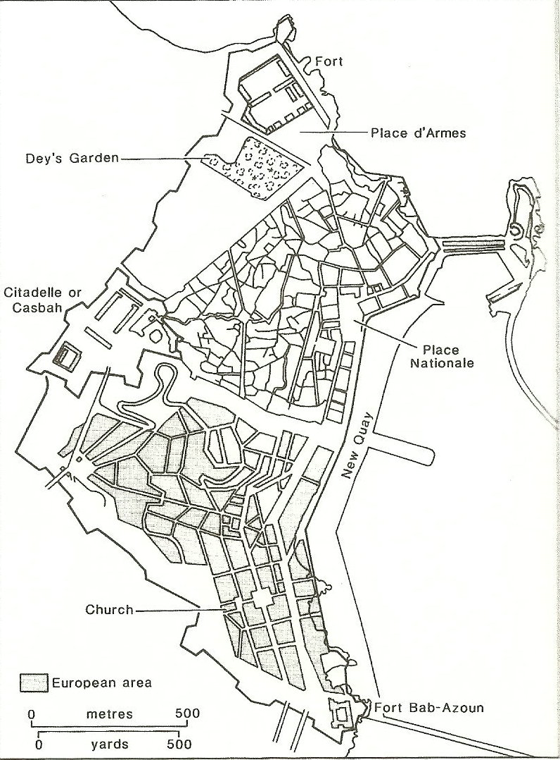
Algiers in 1850
Algiers remained the largest European city on the continent in terms of European population from soon after its conquest until the early 1930s.
It remained the second largest European city until independence in 1962 when many Europeans returned to France.
Note the two distinct sections of the city, the Moslem medina is located is the northern portion of the city. The new European city is located towards the southern section of the town.
A boulevard was constructed between the two sections to separate the two distinct social groups as Haussmann had done in Paris to expel the poor population from the area. This resulted in the Moslem population being forced to live in even more crowded conditions than the poor in Paris

Slide 10
Increased Urbanization leads to the development of slums
From the 1930s onwards Moslems increasingly moved to urban areas.
The medinas already had to contend with the naturally increasing Moslem population.
This trend led to the creation of bidonvilles or tin-can towns.
These towns became more apparent during the late colonial period.
In most cities the government could not keep up with these rapidly growing settlements.
The bidonvilles became a permanent part of the colonial city. Large shantytowns still exist in my cities throughout Africa.

Slide 11
An Attempt at regulating the shantytowns
Most Moroccan towns were built under strict French planning and regulation; however, Casablanca was an exception.
Shantytowns became even more extensive in Casablanca during the 1930s when the colonial government was crippled by the depression.
After the Second World War the French demolished the bidonvilles and constructed a series of regularly laid out suburbs (citiés)

Slide 12
The Evolution of the North African Colonial City

Slide 13
Exceptions to the dual form of North African cities
In Morocco and Tunisia well developed urban systems were in place before colonial times; however, Algeria possessed a poorly developed urban network.
The French developed new town such as Philippeville (1838) and Sidi-bel-Abbes (1843) in an attempt to create an urban network; however, these new towns had trouble attracting settlers.
Already established urban areas continued to grow at a more rapid rate. See the module on colonial capitals.

